Slide 1

LOGIQ
Jianyang Gu, 08.10.2025

Slide 2
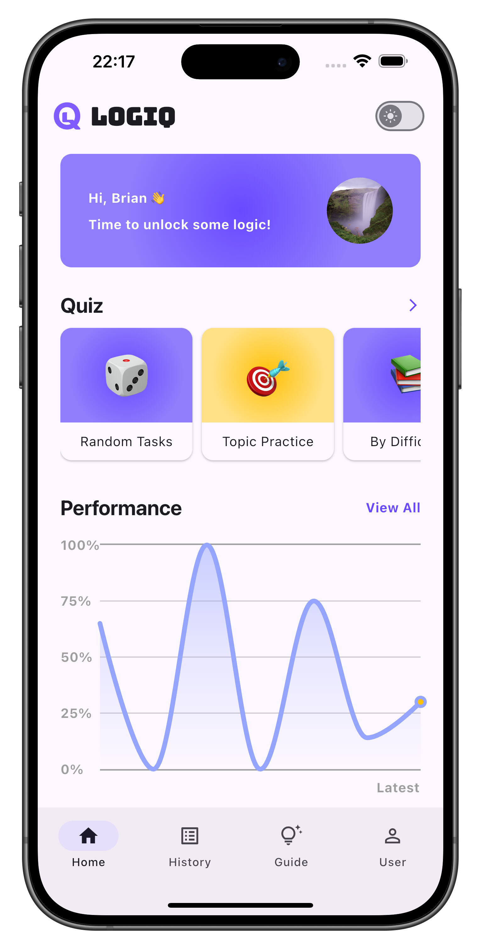
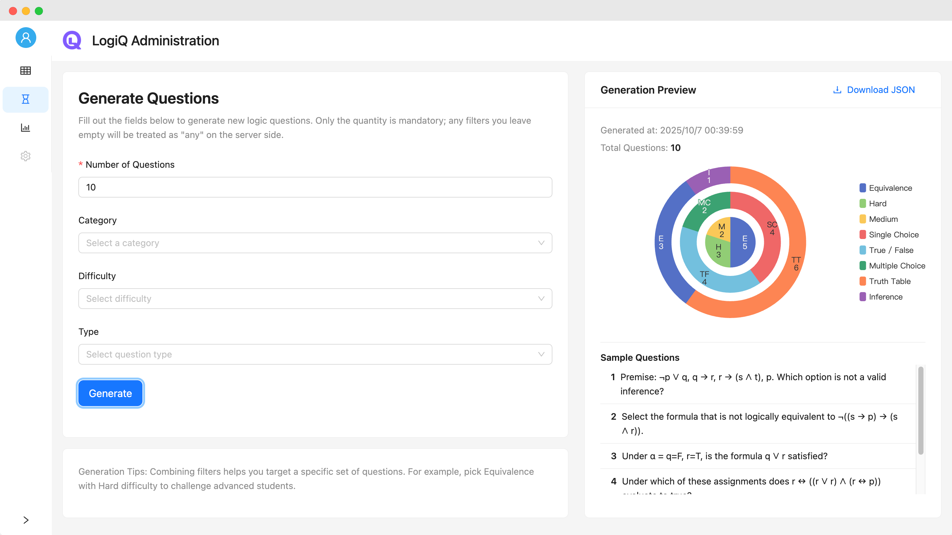
Introduction
Overview
Live Demo
Implementation
Conclusion

Slide 3
Introduction

Slide 4







Introduction
Features
Tech Stacks
Cross-platform logic quiz app
Propositional reasoning
Diversity of tasks
Feedback & analytics

Slide 5
Overview

Slide 6
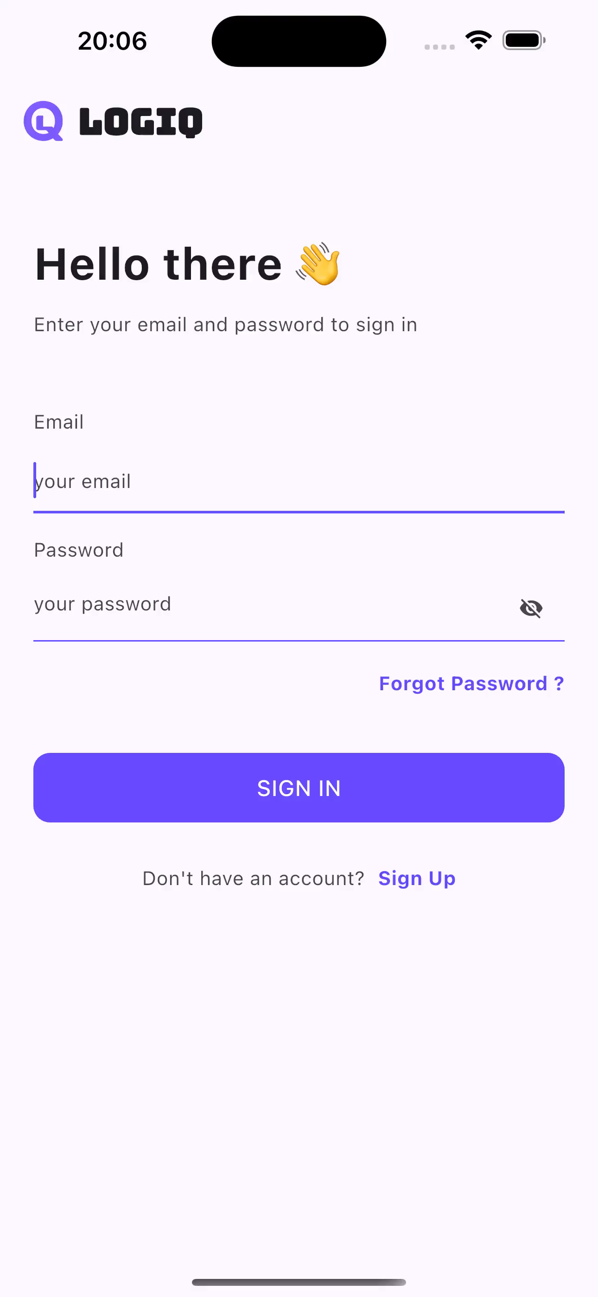
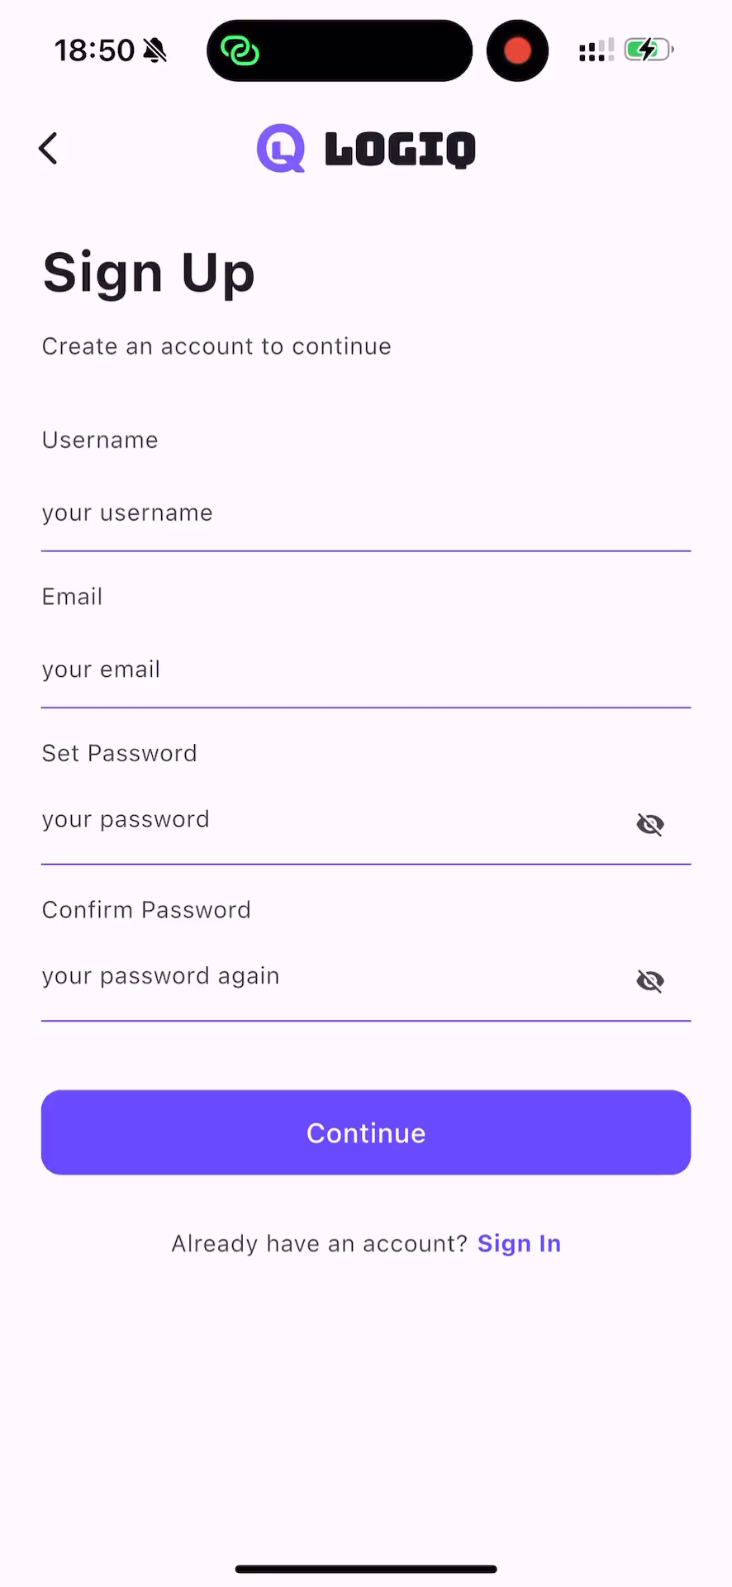
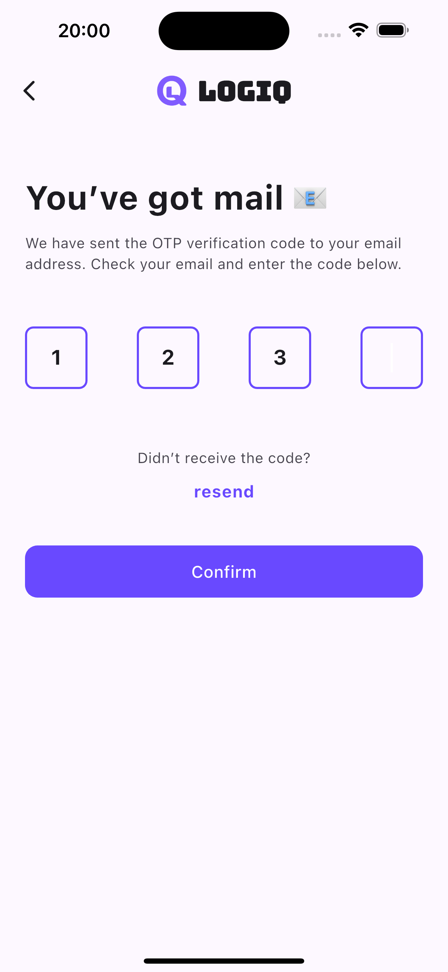
Overview
Frontend App
Login & Registration
Home
Quiz
Review
Profile

Slide 7
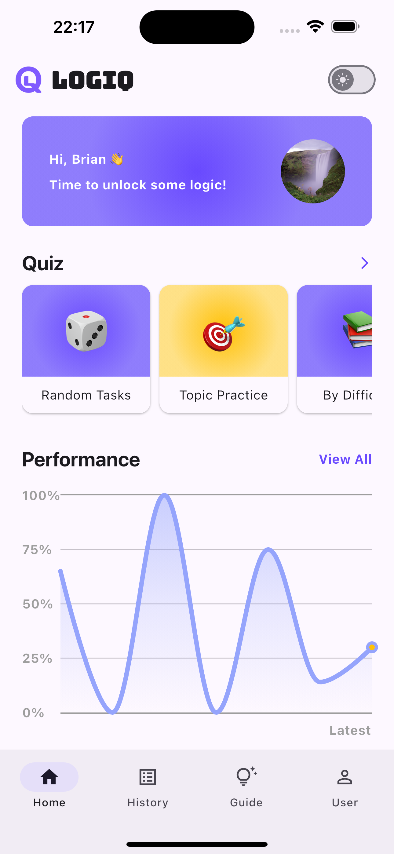
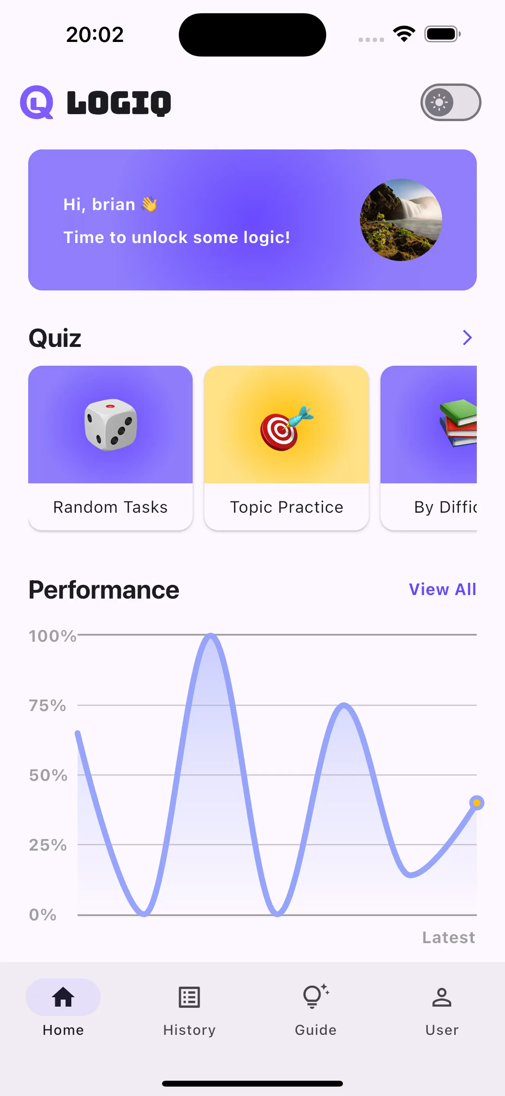

Overview
Frontend App
Login & Registration
Home
Quiz
Review
Profile

Slide 8

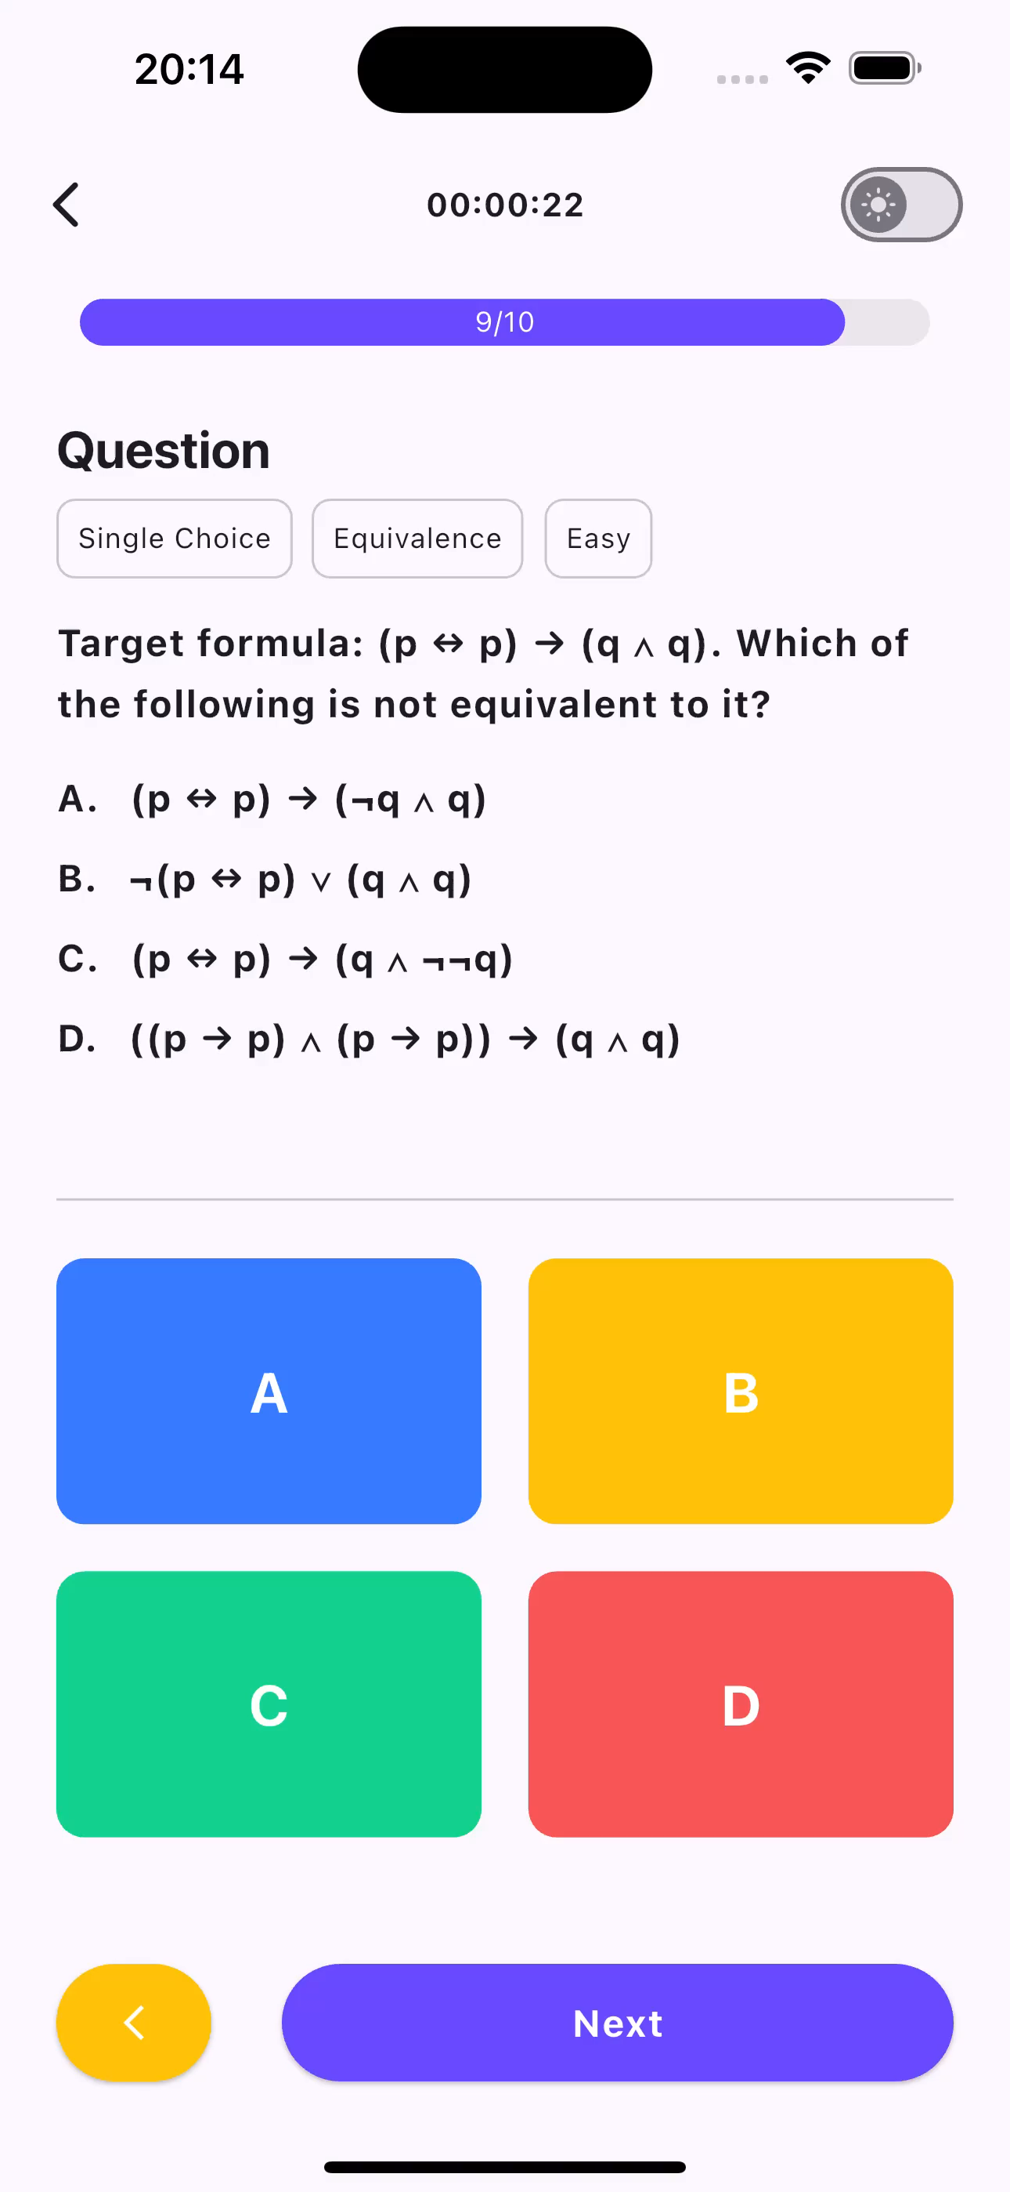
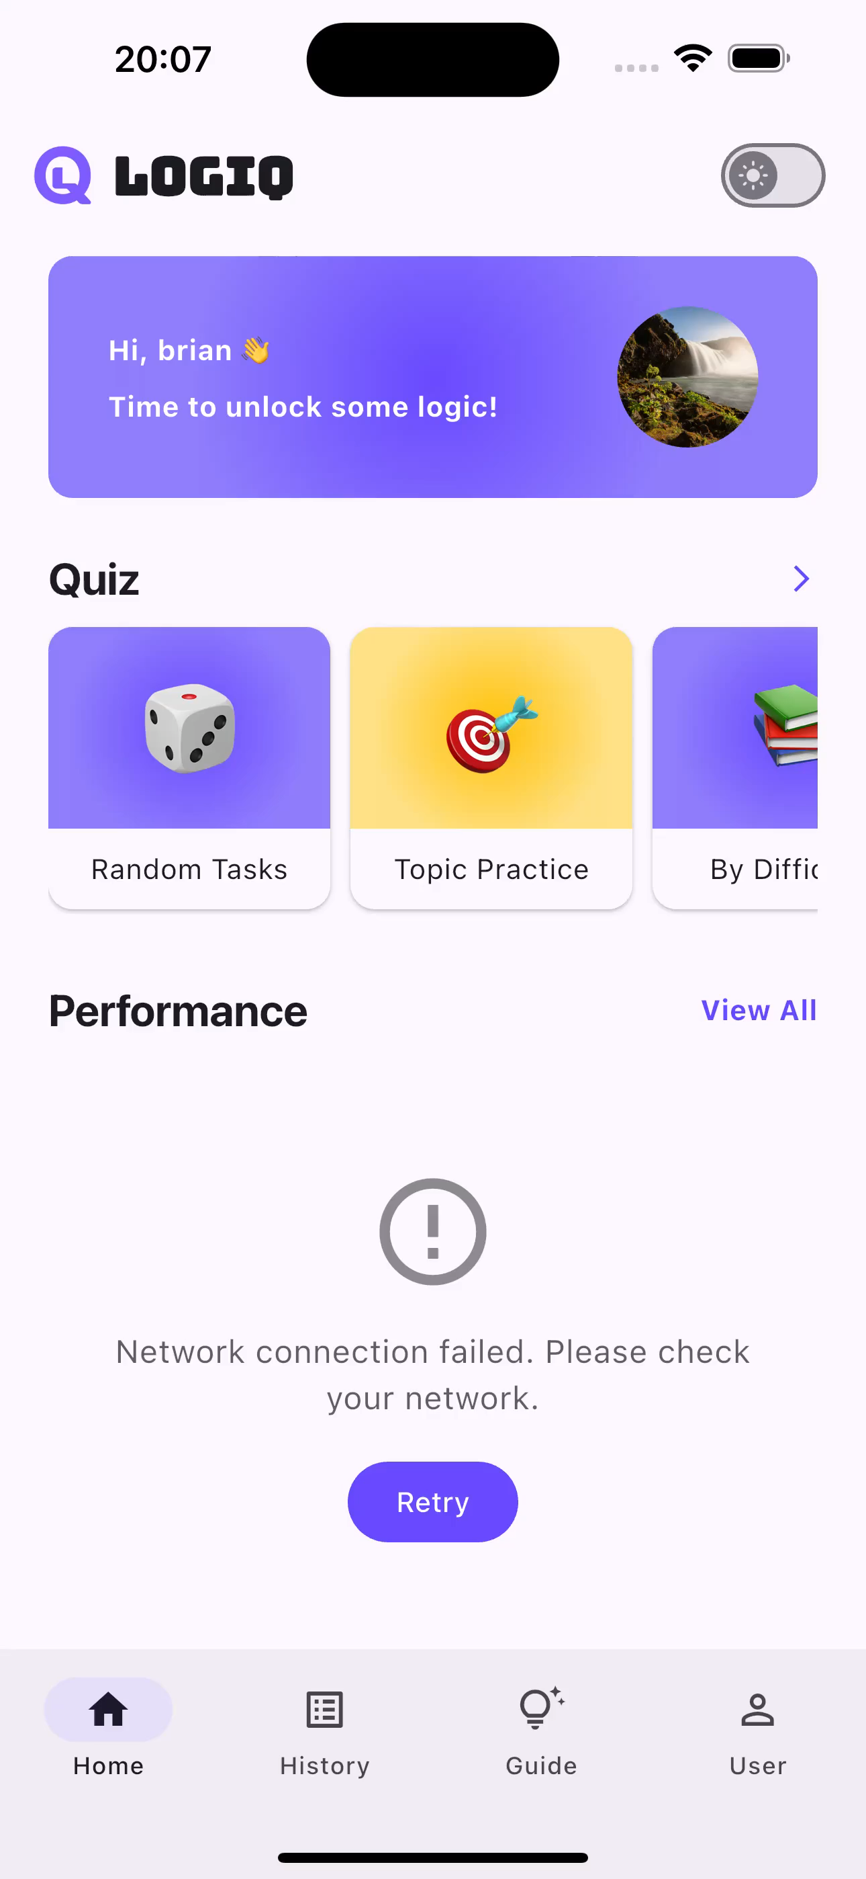
Overview
Frontend App
Login & Registration
Home
Quiz
Review
Profile

Slide 9
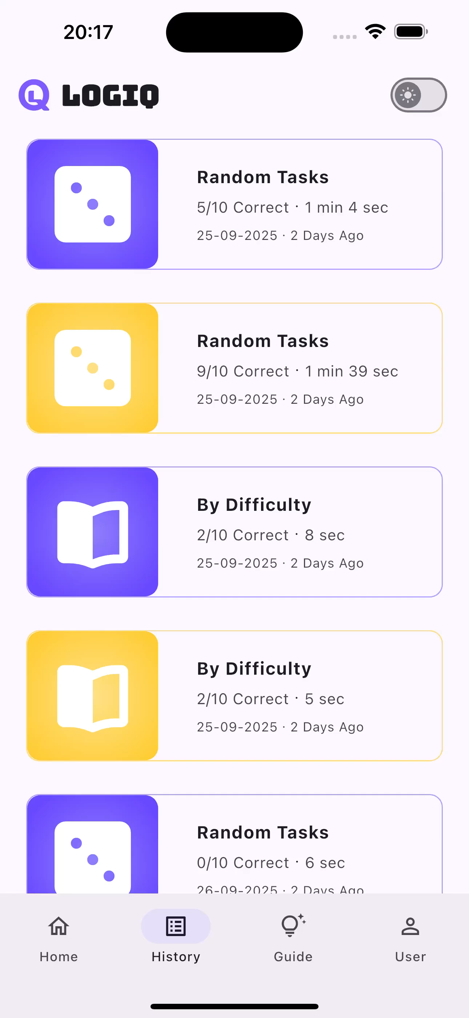
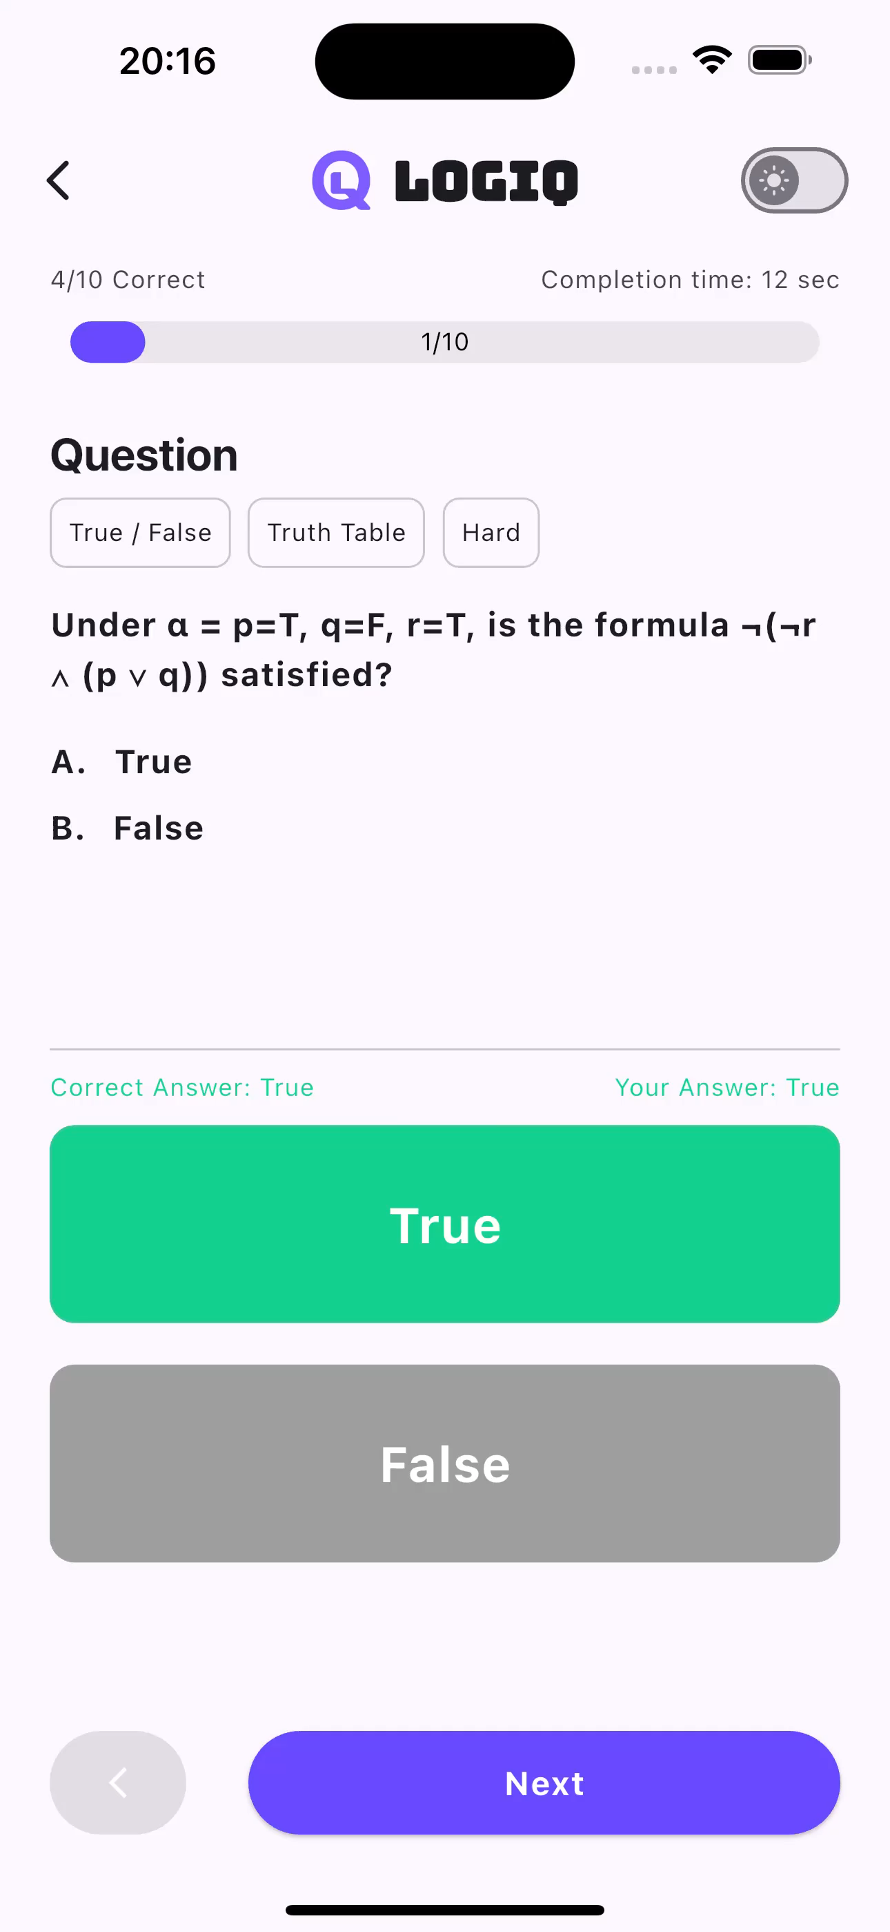
Overview
Frontend App
Login & Registration
Home
Quiz
Review
Profile

Slide 10
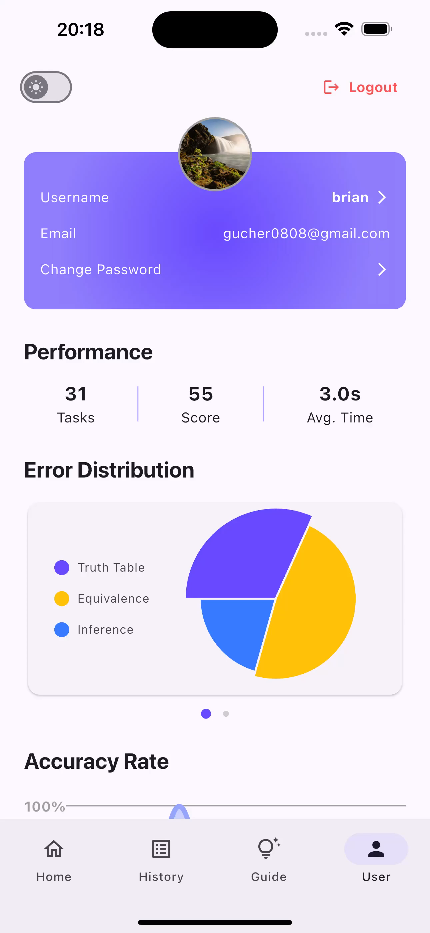

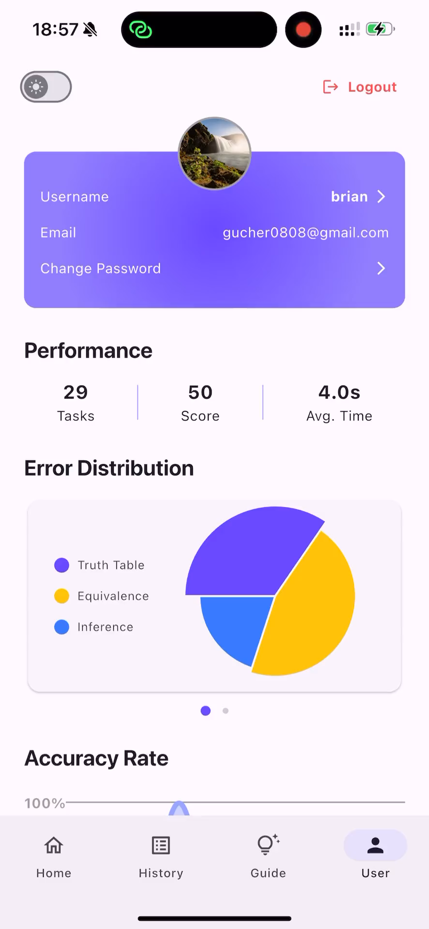
Overview
Frontend App
Login & Registration
Home
Quiz
Review
Profile

Slide 11
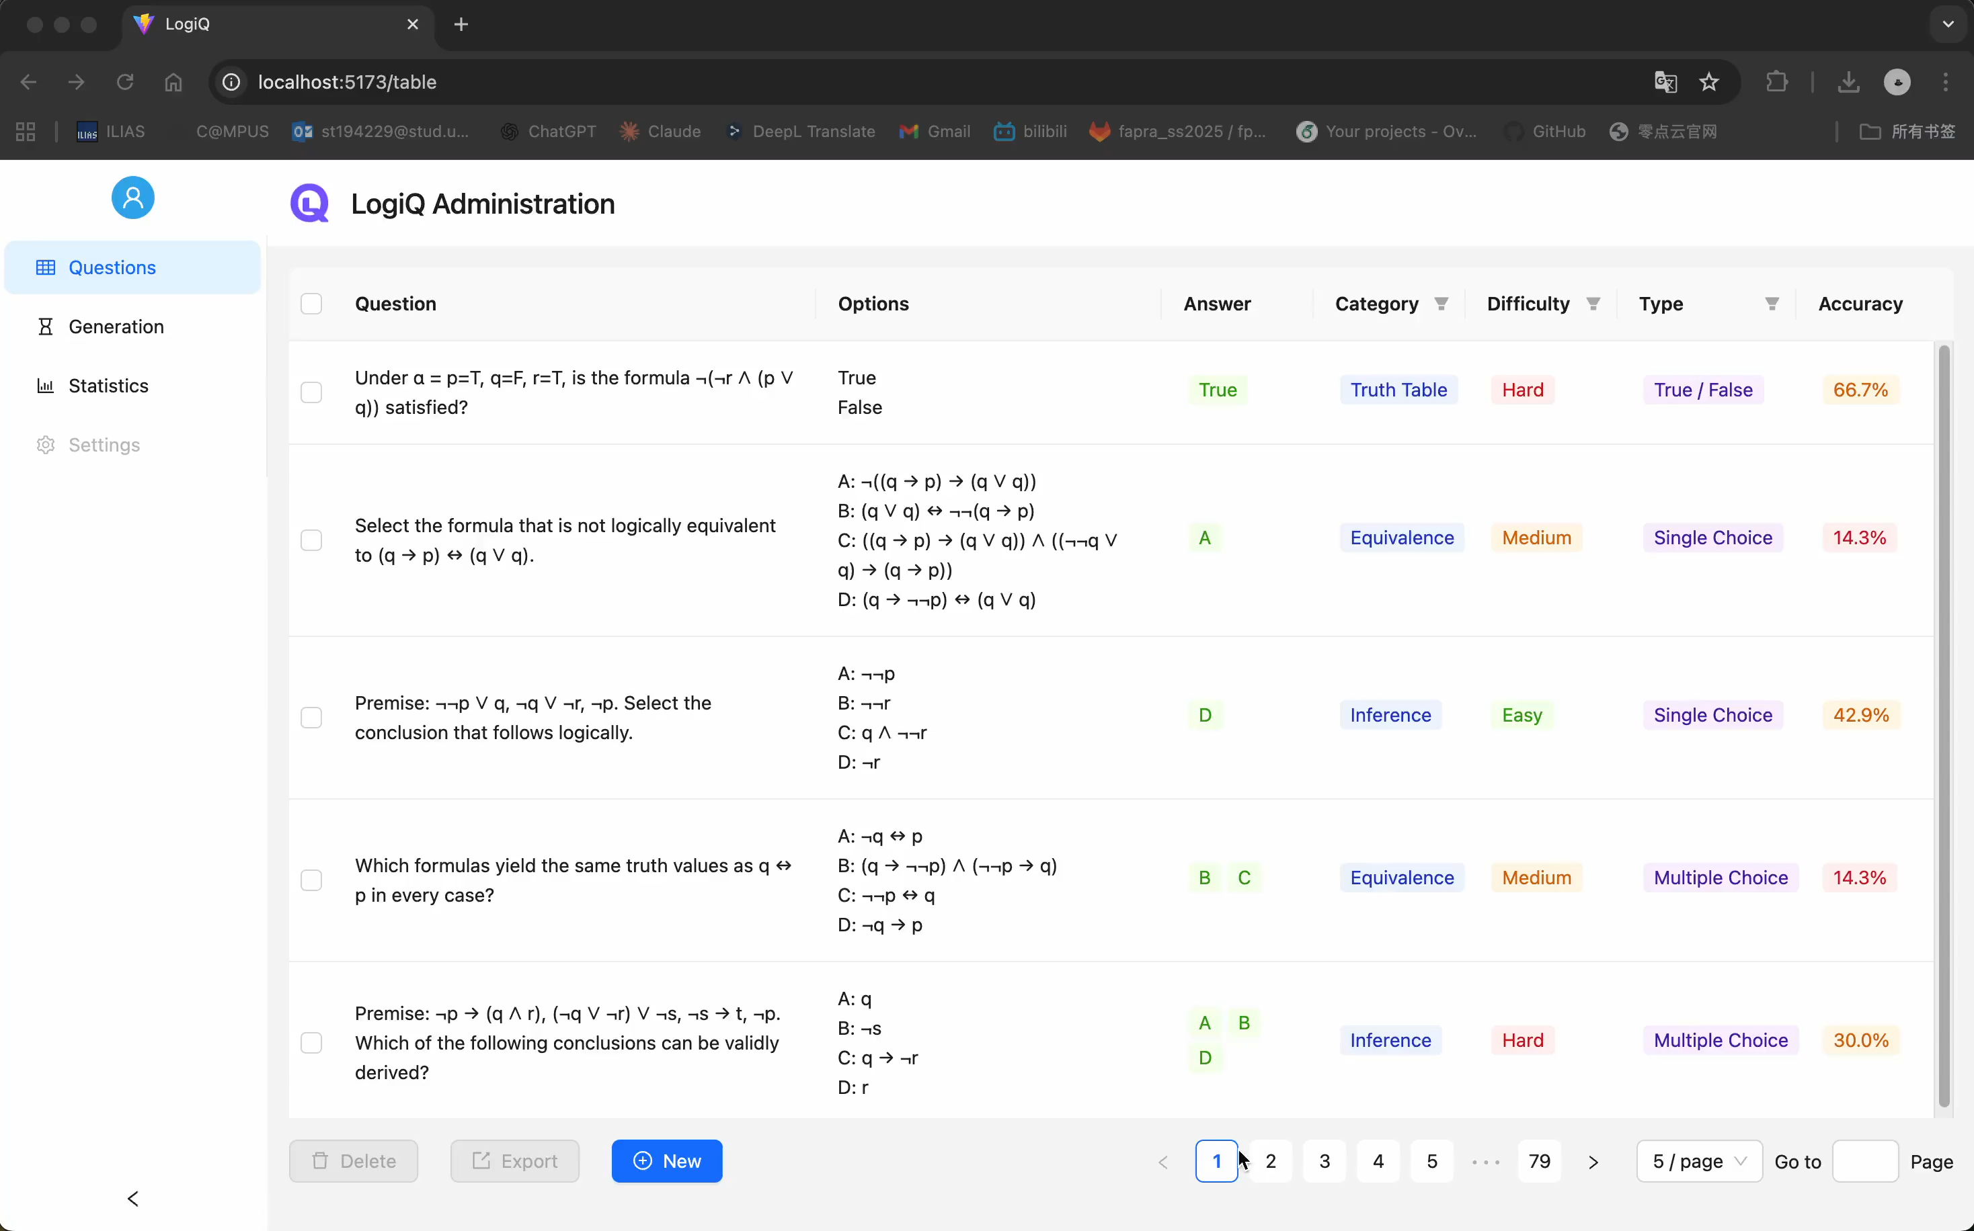
Overview
Admin Site
Question Bank
Delete & Export
Automatic Generation
Statistics Visualization

Slide 12
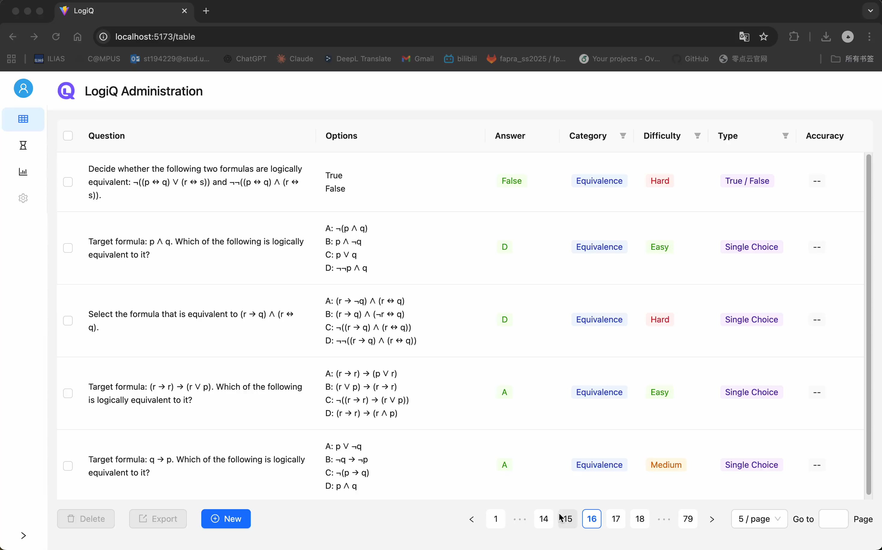
Overview
Admin Site
Question Bank
Delete & Export
Automatic Generation
Statistics Visualization

Slide 13
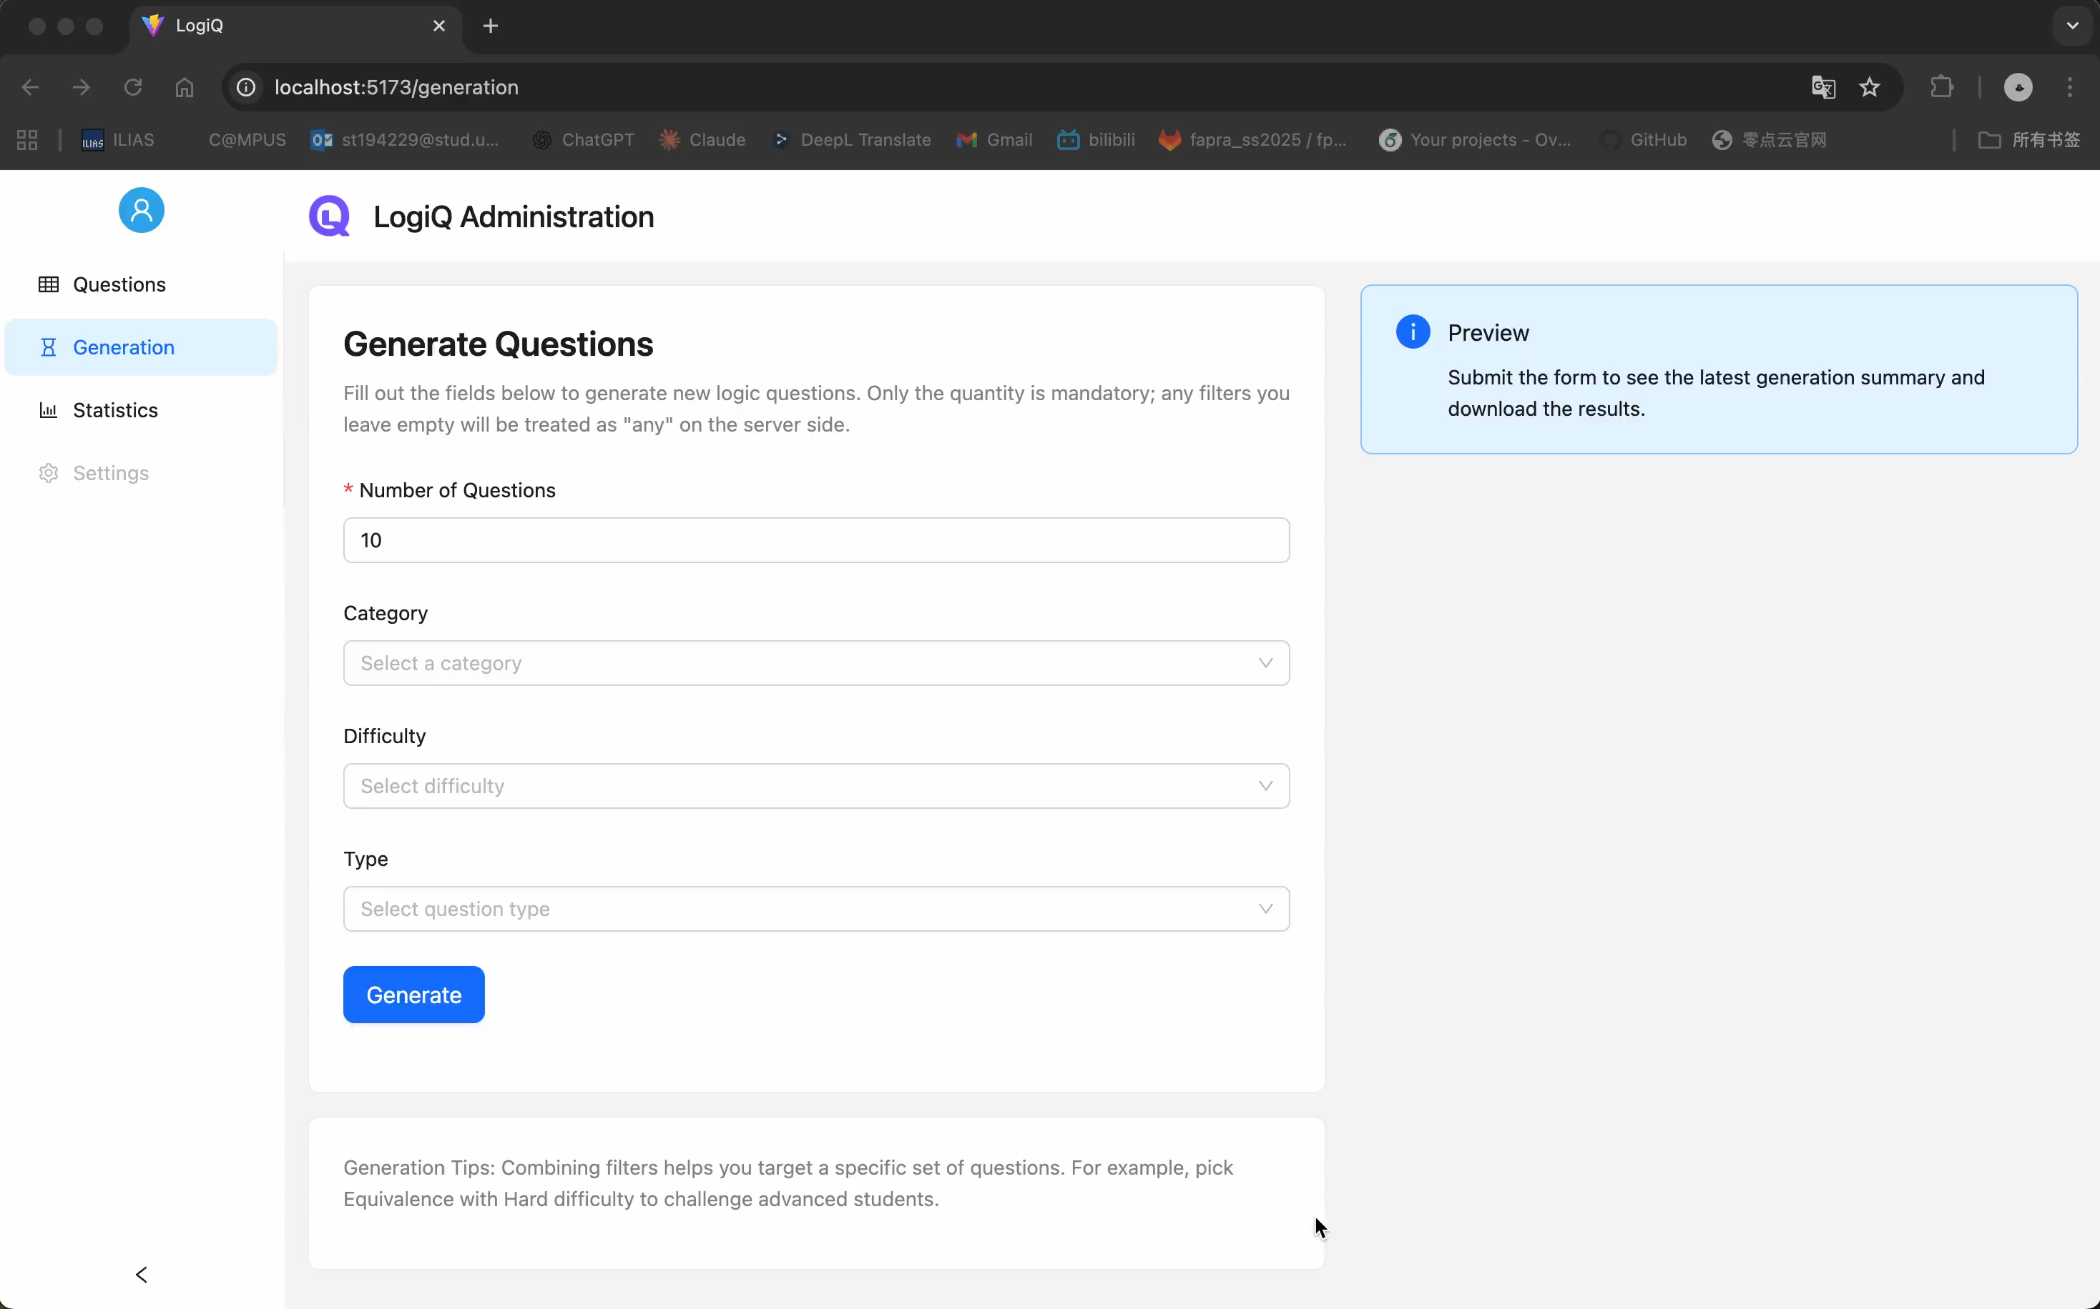
Overview
Admin Site
Question Bank
Delete & Export
Automatic Generation
Statistics Visualization

Slide 14
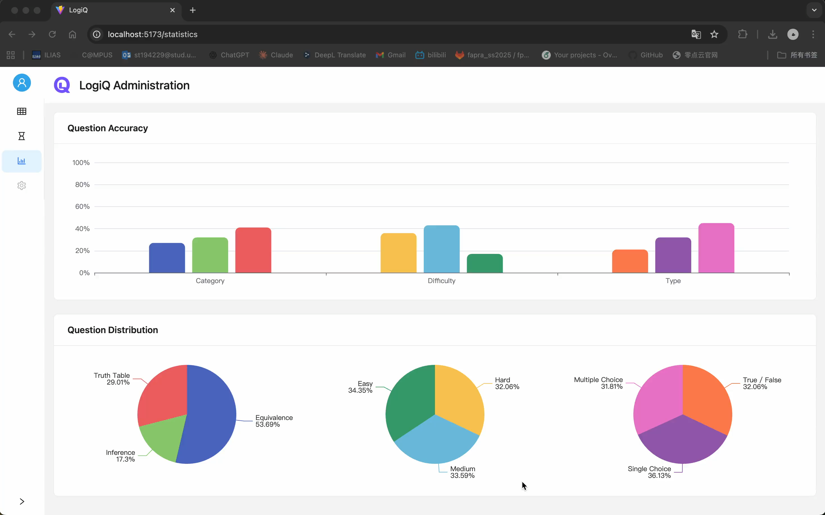
Overview
Admin Site
Question Bank
Delete & Export
Automatic Generation
Statistics Visualization

Slide 15
Live Demo

Slide 16
Implementation

Slide 17
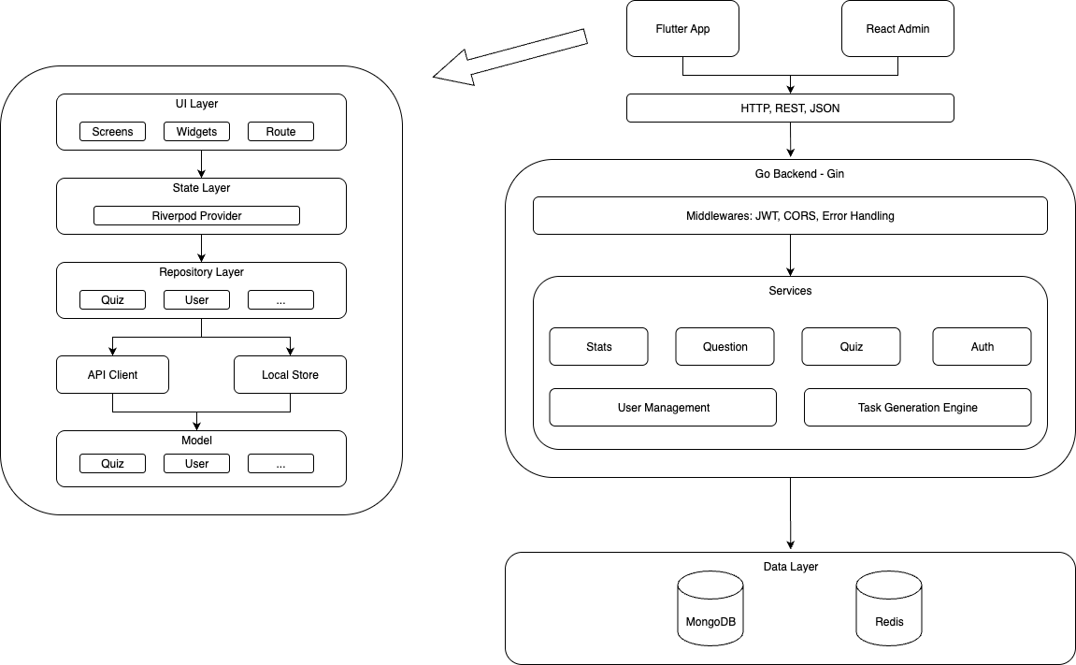
Implementation
Architecture of LogiQ
Notes:
Stats和原本的model分开
前端repository层的意义
Redis作用

Slide 18
Implementation
Architecture of LogiQ
Notes:
Stats和原本的model分开
前端repository层的意义
Redis作用

Slide 19
Implementation
Architecture of LogiQ
Notes:
Stats和原本的model分开
前端repository层的意义
Redis作用

Slide 20
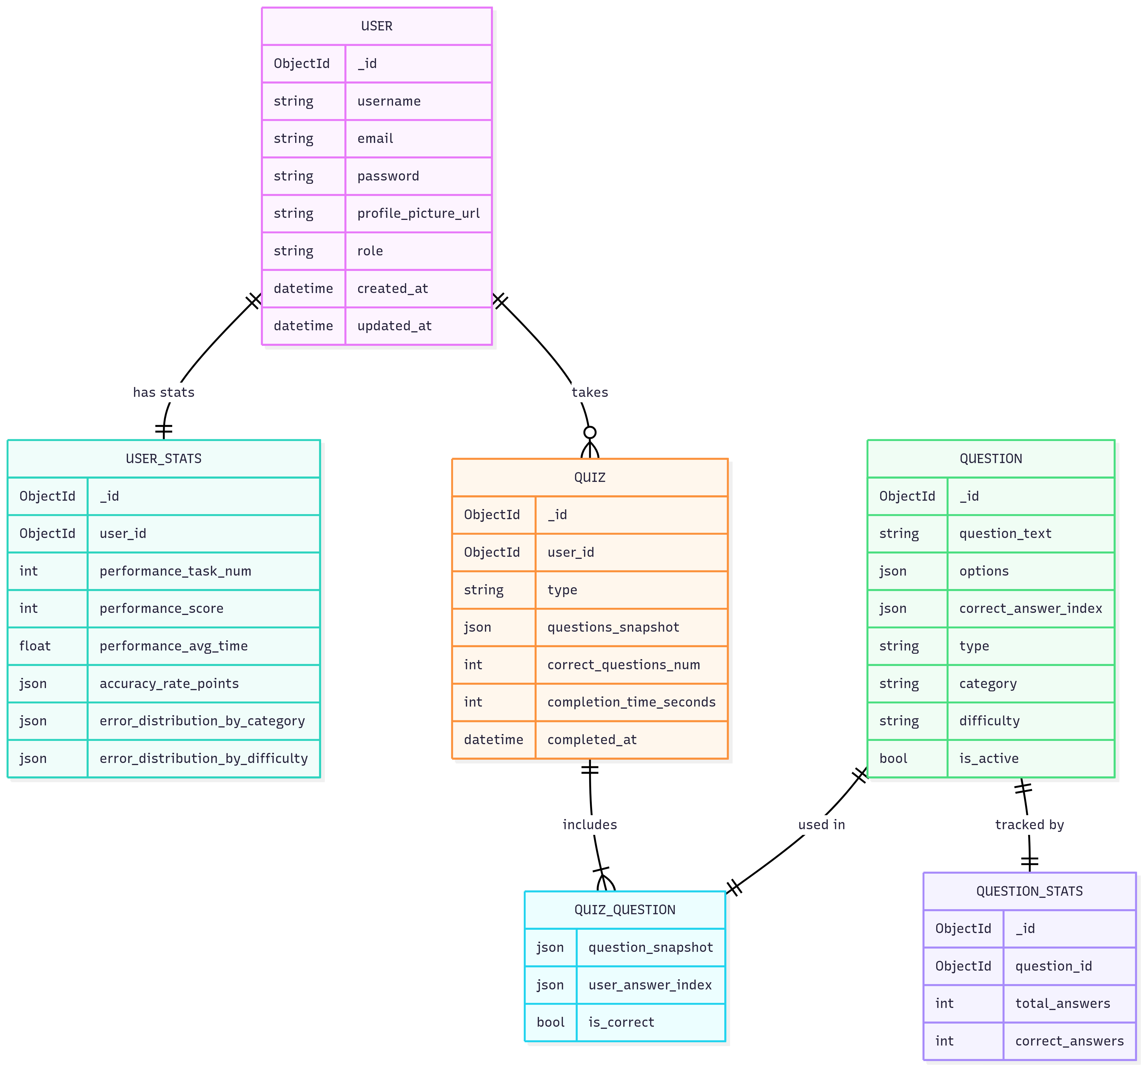
Implementation
ER Diagram of LogiQ
Notes:
使用nosql而不是传统数据库，tradedoff
Quiz question设计的意义 Question的copy价值

Slide 21
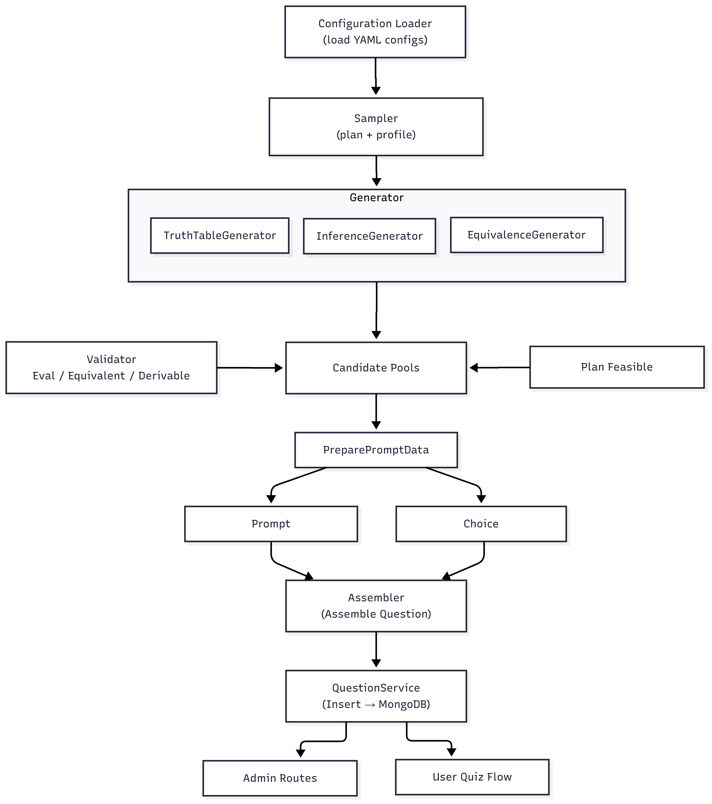
Implementation
Automatic Task Generation
Configuration-driven
Sampler
Generator
Builder
Assembler
Service

Slide 22
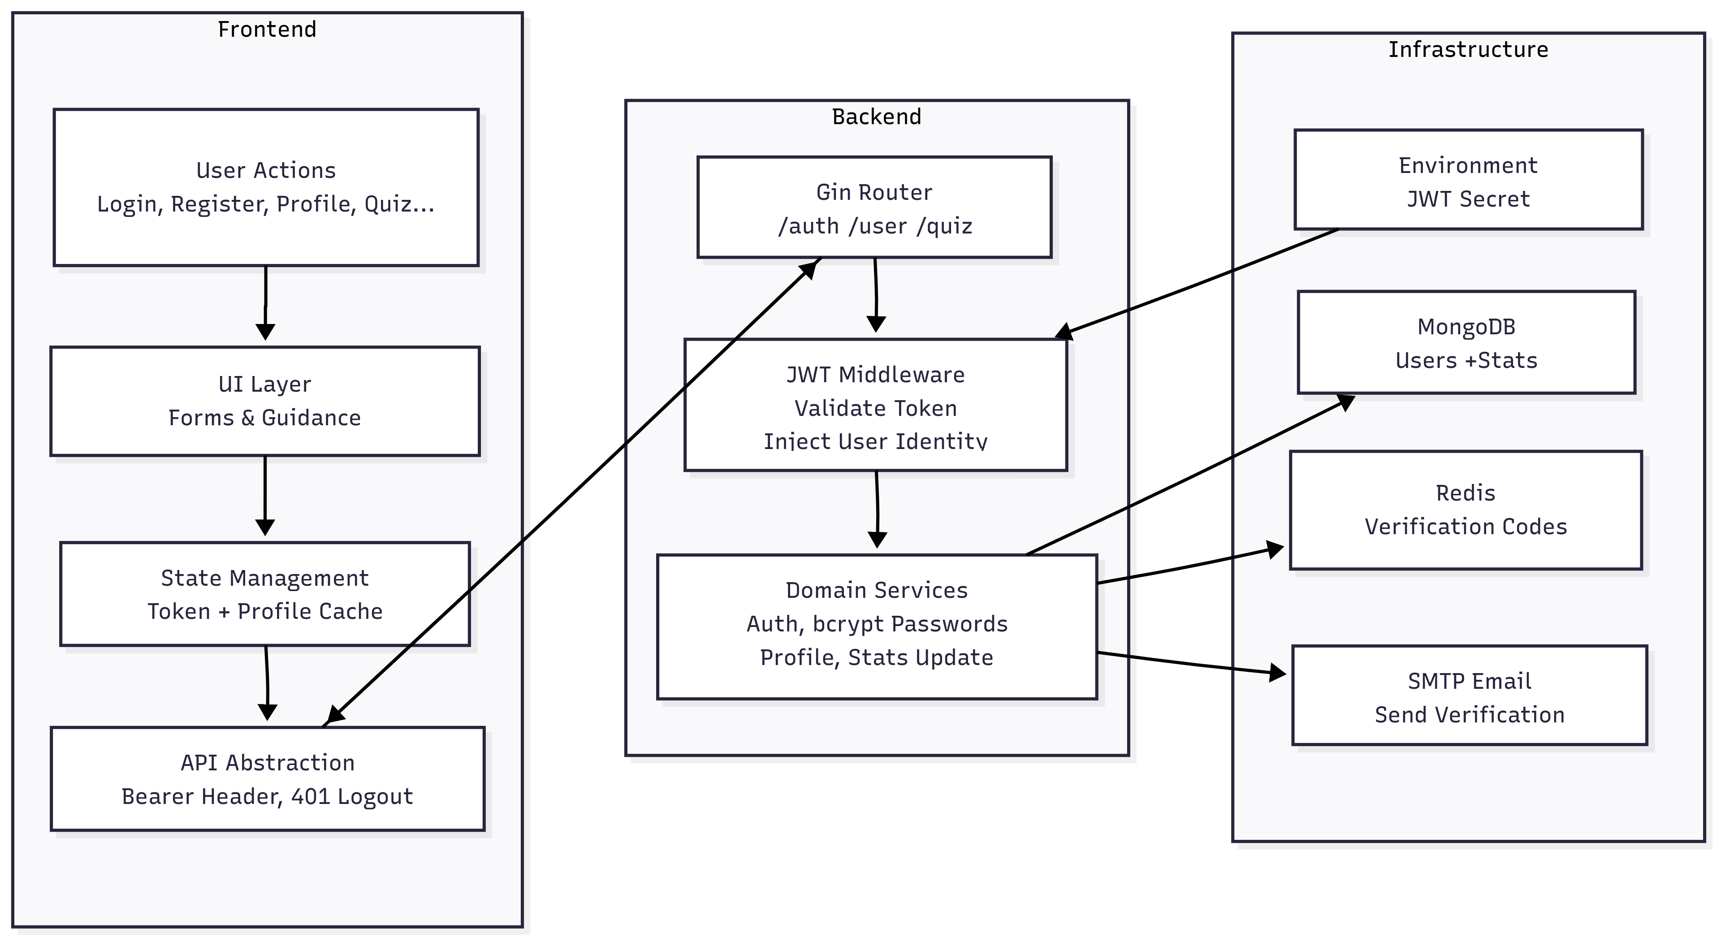
Implementation
User Management

Slide 23
Conclusion

Slide 24
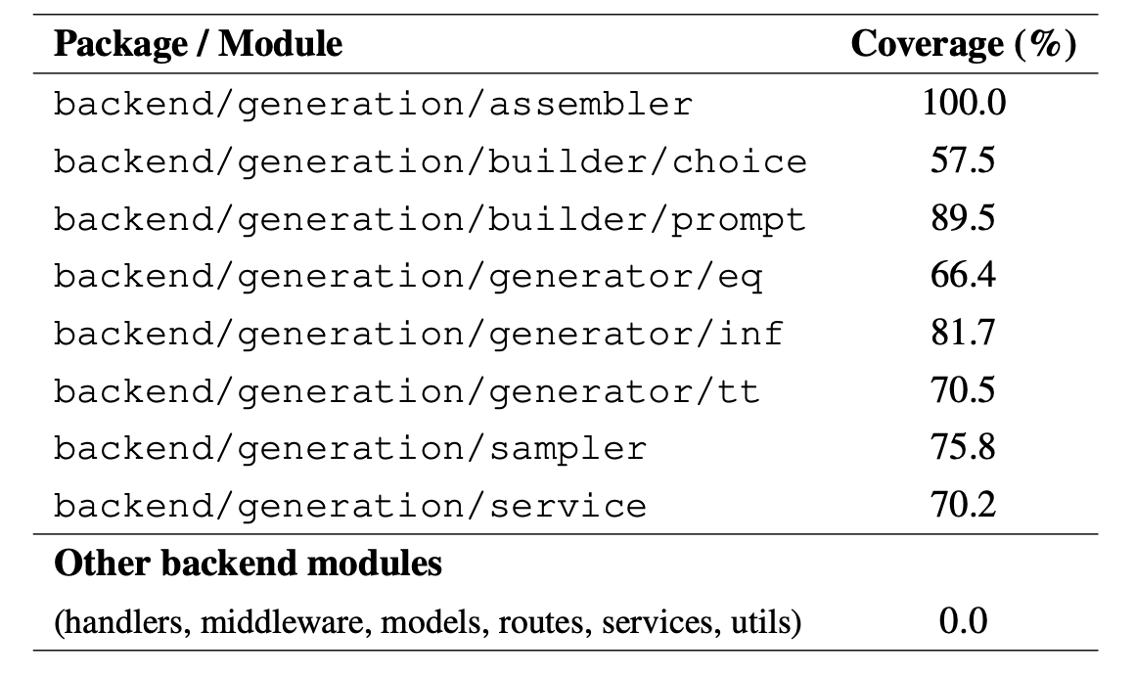
Conclusion
Future Improvements
Unit Testing
API Testing
Frontend: manual verification on ios simulator only.

Slide 25
Conclusion
Future Improvements
App
Admin
Backend
Login System
Authentication
E-mail
Draft
Leaderboard
Setting Page
YAML Config
Logging Service
Delete
Generate
Async Processing
Go Routine
Query Optimization

Slide 26
Conclusion
Learnings & Reflection
Learnings
Full stack hands-on experience
Containerized deployment.
Problem-solving & engineering discipline
AI Tools
Explore potential solutions
Analyze architecture trade-offs
A mentor

Slide 27
Vielen Dank！
Jianyang Gu
08/10/2025
Universität Stuttgart

